Slide 1
U.S. border crossing entry visualization
Team: Quadra Q
WU Zhiwei XU Xiaohan Liu Ran Caihairui
15.12,2019

Slide 2
CONTENTS
Background and Data
Design goals and rationale
Visualization design
Contributions and Conclusion

Slide 3

Background
Imported goods can have multiple effects on a country. Research on imported goods is particularly important.
In this project, we combined the characteristics and types of data to design a complete and comprehensive visualization project. The inner relationship in the Border Crossing Entry Data of United States can be displayed intuitively.

Slide 4
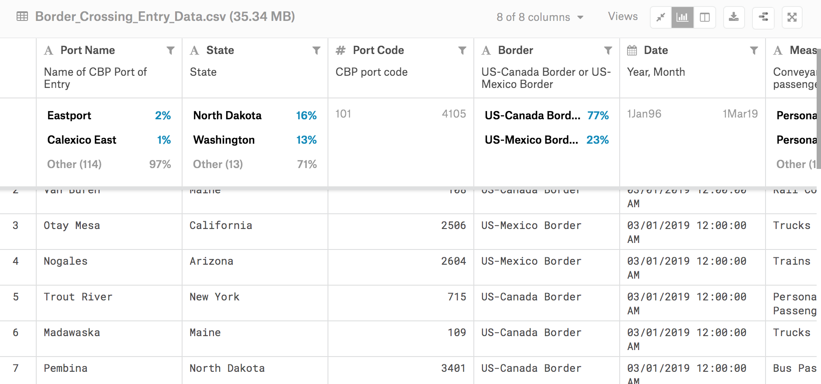
Data
Source
Kaggle.com (https://www.kaggle.com/stevezhenghp/airbnb-price-prediction)

Slide 5
Part 2: Design goals

Slide 6
Design goals
From a lot of research on import trade, we find that the main concerns are as follows:
Where are the goods imported from?
the state and port name
How total value of imported goods changed by state over time.
the change of volume over time
How are imported goods imported? What percentage of each method?
air , rail or trunk

Slide 7
Design Rationale
Rationale 1:Present the relationship of ports and destination.
According to the T1, for a continent, our project needs to show the origin of the goods.
Rationale 2: Show the value and trends
Rationale 3: Interactive and intuitive

Slide 8
Part 3: Visualization design

Slide 9
Project Outcome
interpretable dataset
apply various data cleansing methods and feature engineering means to generate an interpretable dataset
data processing summary
prediction model
compare the performance of all the methods.
used and pick the best one as our final strategy for house price predicting
prediction summary
data visualization result
use a variety of tools to visualize the original dataset, making the data and the predicting results more intuitive and vivid.

